Slide 1
Cultivating A11y-ship Through Case-Based Learning
A Work in progress
Natalie L. Shaheen, Mary Ann Wojton, Matthew Hagaman, Mutiara Syifa, & Nicole White

Slide 2
Overview
Problem
Work in Progress
Inaccessible instructional technologies
Inequities for blind and low-vision (BLV) students
Evades teachers’ notice
Case library: harmful impacts of inaccessible technology
Case-based learning (CBL) unit
Implemented in undergraduate & graduate teacher prep program with future teachers of blind students
External evaluation

Slide 3
ADA Title II Regs
Rule
WCAG 2.1 AA
Compliance: April 24, 2026
State & local government: K-12 schools
Websites
Mobile apps
Web Content Accessibility Guidelines
Technical standard:
POUR: Perceivable, Operable, Understandable, & Robust
Headings <h1>, <h2>….
Alternative text
Descriptive/meaningful links: CLICK HERE

Slide 4
Cultivating A11y-Ship
A commitment to creating born accessible classes
Proactive not reactive
Disabled students can show up any time and learn alongside their peers
Accessible technology & pedagogy
Examining power structures, particularly ableism
Opportune time to cultivate a11y-ship among preservice teachers

Slide 5
Status quo
Inaccessible instructional technologies are a systemic problem in K-12 (Shaheen & Lohnes Watulak, 2019)
Lack of knowledge among educators
Educators are unaware that
Technologies can be inaccessible
How inaccessible technologies harm BLV students
How to tell whether a technology is accessible
Several laws mandate accessible technologies in K-12

Slide 6
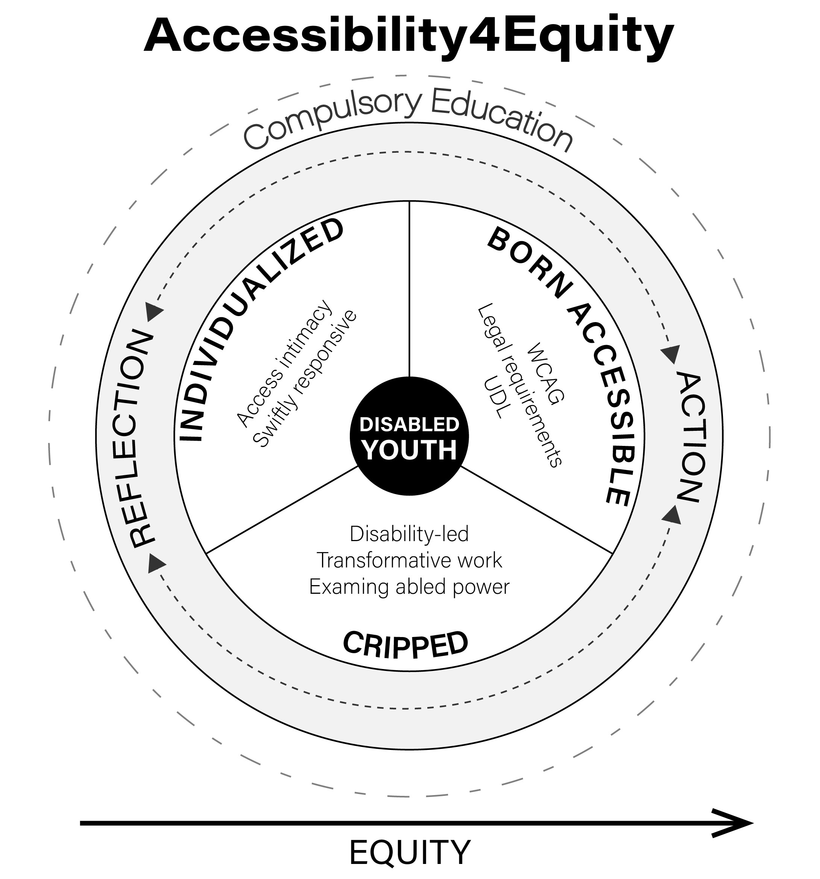
Theoretical Framework: Accessibility4Equity
sociotechnical praxis to disrupt systemic ableism & construct born accessible technology-mediated classes
Pedagogy: Universal Design for Learning
Technology: WCAG
Reflection: how ableism shapes decisions about which learning supports are inherent versus auxiliary
(Shaheen, 2022)

Slide 7

A11y in Sci Case Library
Research-based short stories
BLV students & their teachers learning & working in in/accessible tech-mediated classes
15 stories (so far)
Prioritized accessibility in dev process
Interface: filtering, glossary, character bios
Case metadata: instructional tech, assistive tech, WCAG
Case library

Slide 8
Stories
Simulation Frustration relays Captain Marvel’s experience with inaccessible biology simulations and her teachers’ failed attempts to make the technology-mediated unit accessible.
Sometimes I Cry describes the shame and despair Rebecca felt when selecting high school classes based solely on how accessible she thought they would be.
In Kahoot Kapoot three blind teens put Kahoot on blast and strategize about how to get their teachers to ditch the “game.”
Accessibility 101 shares a first-year teacher of blind students’ nerve-wracking experience providing accessibility PD to a veteran science teacher.

Slide 9
CBL Unit for Preservice Teachers of Blind Students
Undergraduate & graduate BLV AT course
1st unit
5 weeks
Extensive reading from case library: primarily student-selected cases
Reflection
Guided inquiry into the complexities of teaching and learning
(Akbulut & Hill, 2020; Hoffer, 2020)

Slide 10
WK 1 Asynchronous Lab
You are a teacher of blind students in a suburban district in New England. You have some high achieving students on your case load this year, including Captain Marvel. She uses screen readers to access all her classes, except English and Latin where she uses Braille. You've been working hard over the first two weeks of school to get the gen ed teachers up-to-speed. But there are so many of them and only one of you.
Yesterday, after school, you got a text from Captain Marvel; her biology teacher, Ms. Walsh, used an inaccessible photosynthesis simulation in class. According to Kylie Walsh, simulations are a large part of the bio curriculum. You've heard that the simulations Kylie is using are an accessibility dumpster fire.
What would you tell Ms. Walsh?
Assign Captain Marvel appropriate readings from the textbook instead
Let Captain Marvel read her independent reading book
You'll have Mrs. Brown, the para, help Captain Marvel do the simulations

Slide 11
Week 2 In Class
Simulation frustration; small group activity
Approach to addressing inaccessible bio sim | Captain Marvel (Student) | Ms. Walsh (Sci Teacher) | Mrs. Collins (TBS)
Read Independent reading book or do homework | Main Challenges: Feelings: | Main Challenges: Feelings: | Main Challenges: Feelings:
Have para (Mrs. Brown) help with simulation | Main Challenges: Feelings: | Main Challenges: Feelings: | Main Challenges: Feelings:
Read textbook | Main Challenges: Feelings: | Main Challenges: Feelings: | Main Challenges: Feelings:

Slide 12
Week 3 In Class
After learning about WCAG
Small group activity
Identify the WCAG principles (POUR) and guidelines related to the cases you’ve read so far
Check your ideas against the case metadata

Slide 13
Unit Culminating Project
Your accessibility story
2 options
The story of learning about accessibility as a preservice teacher at ISU
The story of how your future self (a fifth-year teacher) incorporates accessibility into their teaching practice
Any format: prose, poetry, spoken word, imagery, etc.
Story must be accessible

Slide 14
Preliminary External Evaluation Findings
Increased understanding of:
Barriers BLV students encounter when technologies are inaccessible
Accessibility errors that are common in instructional technologies
Actions teachers can take to mitigate barriers
“Understanding how to make something accessible, like docs and slides. It can help prevent these problems the cases talk about.”
“I’ve been looking at [instructional technologies] other professors use and wondering, would I be able to use it? Is it accessible to BLV students?”
Constructive feedback:
Are the stories real?
More teacher POV
Stories from earlier grades

Slide 15
Incorporating the Case Library into Teacher Prep
Beta case library is publicly available
Hook or foundation for accessibility units
Instructional technology courses: select cases that address the tech you are discussing
Technology | Story
Gamification | Kahoot Kapoot
Simulations | Sometimes I Cry & Simulation Frustration
Interactive Whiteboards | Whiteboard Woes
CAD | Accessibility Fail in Engineering Education
Student Information Systems | Getting my Grades
Computer-aided tests | Testing the System

Slide 16
Continued work
Refining interface
Writing more cases: Teacher POV
Refining CBL unit for preservice teachers of blind students
Developing CBL unit for preservice gen ed HS teachers
Ultimately OERs
CBL unit for teachers of blind students
CBL unit for gen ed

Slide 17
We would love your feedback
If you choose to use (or not use) the case library in your courses, we’d love to know what did and did not work
info@a11ys.org

Slide 18
Thank you!
This material is based upon work supported by the National Science Foundation under Award No. 2334693. Any opinions, findings and conclusions or recommendations expressed in this material are those of the author(s) and do not necessarily reflect the views of the National Science Foundation.

Slide 19
References
Akbulut, M. S., & Hill, J. R. (2020). Case-based pedagogy for teacher education: An instructional model. Contemporary Educational Technology, 12(2). https://doi.org/10.30935/cedtech/8937
Hoffer, E. R. (2020). Case-based teaching: Using stories for engagement and inclusion. International Journal on Social and Education Sciences, 2(2), 75-80. https://files.eric.ed.gov/fulltext/EJ1263931.pdf
Shaheen, N. L., & Lohnes Watulak, S. (2019). Bringing disability into the discussion: Examining technology accessibility as an equity concern in the field of instructional technology. Journal of Research on Technology in Education. 51(1), 187–201. https://doi.org/10.1080/15391523.2019.1566037
Shaheen, N. L. (2022). Accessibility4Equity: Cripping technology-mediated compulsory education through sociotechnical praxis. British Journal of Educational Technology. 53(1), 77-92. https://doi.org/10.1111/bjet.13153

